Slide 1
INTRODUCTION TO THE MODULE AND THE BIOPSYCHOSOCIAL MODEL
Ngozi Onuegbu PhD
Module Lead: PT7001; PT4050

Slide 2
Applied Sciences for Physiotherapy Practice
Module contents – aims and objectives
Module delivery: How will the course be delivered?
Module assessment: How will you be assessed?

Slide 3
Module Content
Anatomy
  Central nervous system (CNS) functional anatomy (cortex, cerebral blood flow, brainstem & cranial nerves, ascending & descending systems, basal ganglia, cerebellum), Peripheral nervous system structure and function (somatic and autonomic).
  Musculoskeletal anatomy: upper & lower quadrants – joints and musculature
  Cardiorespiratory anatomy: thoracic cage, respiratory muscles, lungs and pleura, heart, and coverings.
Physiology:
  Human movement, motor control and motor learning; muscle physiology (skeletal and smooth muscle), biomechanical principles of human movement; exercise physiology; lung biomechanics, function, carriage of oxygen, gas exchange, respiratory drive
Psychological and Social aspects of human sciences to deal with issues affecting health and wellbeing, within a biopsychosocial context
Pathology
Notes:
Health beliefs and behaviour, models, evidence, symptom perception and health seeking, impact of and response to life threatening and long-term conditions, adherence/nonadherence to interventions e.g., exercise.
Stress and resilience, mental health
Sociology
Social determinants of health and global health challenges such as class, ethnicity, sexuality, power differential.
Pathology
Response of muscle, bone and nervous tissue to injury, disuse, and exercise.

Slide 4
Objectives
Develop a systematic understanding of biological and biomechanical sciences that underpin health and well-being in individuals and populations.
Gain a detailed understanding of human tissue at the cellular and tissue level, encompassing their structure, function, and organization.
Demonstrate an understanding of biological and biomechanical knowledge to interpret the signs and symptoms seen in individuals affected by dysfunction in contemporary practice.
Explore scientific concepts on how common problems may affect human function using the biopsychosocial model.

Slide 5
How will the Module be delivered?
The module will run for the whole of your first academic year:
  MSc: PT7001: Year Long
  BSc: PT4050 (Autumn) and PT4054 (Spring)
Modes of learning:
  lectures, seminars, group study, self- directed learning.
Read the module specifications it has all the full content and structure of the module.

Slide 6
How will you be assessed?
MSc: Formative and Summative Assessments
  Biopsychosocial essays and Written exams
BSc: In course, written exams, attendance
Read the module specifications it has all the full content and structure of the module.
Notes:
In-class assessments carried out through the semester as a part of the learning and teaching strategy of the course. This will provide formative opportunities to students and account for 0% of the module mark.
2-hour paper focused on the knowledge and understanding of aspects of human anatomy, physiology and social science taught in the module as it applies to physiotherapy practice.
Students are expected to attend at least 80% of scheduled sessions for the module.

Slide 7
Important Study Tips
Self-directed learning
Group discussions
Personal learning strategies
Optimise!!!!

Slide 8
Biopsychosocial Model
What do you know or understand of the term: Biopsychosocial?
Have you utilized it in your practice before? How?
Are there any hindrances from applying it to your practice?

Slide 9


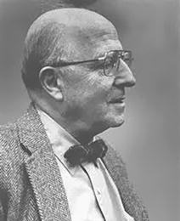

Biopsychosocial model
Applied Sciences for Physiotherapy Practice (PT7001)
Engel G. The need for a new medical model: a challenge for biomedicine.
Science. 1977; 196:
129–136
George Engel, M.D. (1913–1999) Psychiatrist

Slide 10
Old model:
Medical/Biomedical
Engel’s query:
  Dualistic
  Reductionist
  Exclusionist

Slide 11
Biopsychosocial model
Applied Sciences for Physiotherapy Practice (PT7001)
Mind-Body Duality - The biomedical model lends itself to a dualistic separation of mind and body (mind-body duality). A greater focus on the biological/biochemical causes of illness.
Reductionism – “the philosophic view that
complex phenomena are ultimately
derived from a single primary principle”

Slide 12
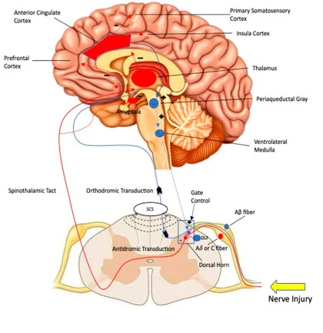
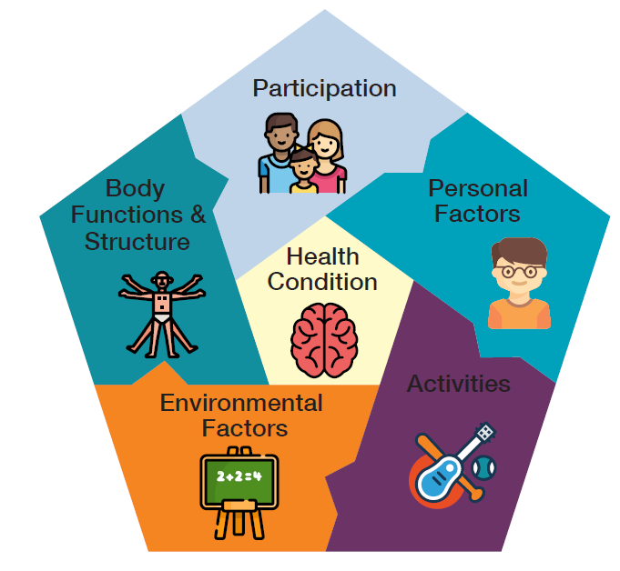
Need for a Paradigm Shift
Biopsychosocial Model:
  Melzack and Wall’s Pain Gate Theory
  ICF Model

Slide 13
25 Years Later: Principles, Practice and Scientific Ebquiry
Holistic Approach: George Engel introduced the biopsychosocial model as a holistic alternative to the biomedical model, emphasizing the need to consider biological, psychological, and social dimensions simultaneously to truly understand and address a patient’s suffering.
Critique of Biomedical Model: Engel critiqued the reductionist and specialized approach of the biomedical model, which tends to dehumanize patients by treating them as objects and neglecting the subjective experience of illness.
New Medical Paradigm: The biopsychosocial model was proposed as a new medical paradigm that includes the patient's subjective experience with objective biomedical data, promoting a more comprehensive and naturalistic model of causation, and transforming the patient-clinician relationship to empower patients.
Integration with Evidence-Based Medicine: The article explores how the biopsychosocial model interfaces with evidence-based medicine, emphasizing the importance of integrating both approaches to improve patient care.
Scientific and Ideological Shifts: Engel’s model responded to shifts in science from exclusively analytic approaches to more contextual and cross-disciplinary perspectives. His approach not only proposed a scientific change but also advocated for a fundamental ideological shift towards re-humanizing medical practice.
Engel (1977); Borrell-Carrió (2004)

Slide 14
Biopsychosocial model
Applied Sciences for Physiotherapy Practice (PT7001)
Biomedical Approach
Mind-Body Duality - The biomedical model lends itself to a dualistic separation of mind and body (mind-body duality). A greater focus on the biological/biochemical causes of illness.
Reductionism – “the philosophic view that
complex phenomena are ultimately
derived from a single primary principle”
Exclusionist: That the existing model excluded psychological and sociological perspectives of health and disease.
Engel’s Objections
This approach places less emphasis of the effects of the mind (psychology) can have on the body.
Somatic disease versus mental
disease
Results in an ‘cold’, dispassionate and overly objective approach to working with people.

Slide 15
Let’s talk about Pain as a medical condition!

Slide 16
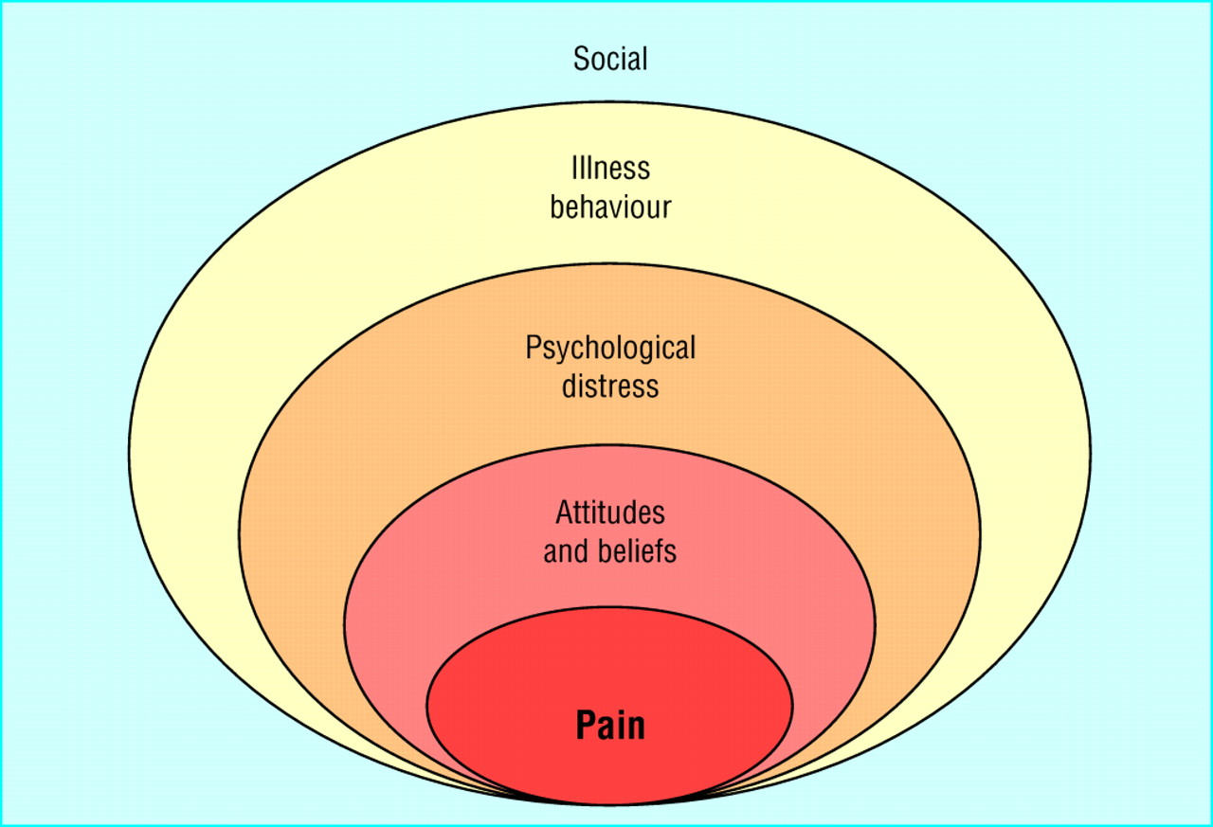
Social
____________________
Psycho
____________________
Bio

Slide 17
Biopsychosocial model
What do we think?
Are his objections still valid today?
Applied Sciences for Physiotherapy Practice (PT7001)

Slide 18
Medical Model | Biopsychosocial Model
Pain, disability, sickness, incapacity for work: entirely a consequence of pathology | Partly a matter of the health condition, but also how the individual, thinks, feels or behaves
Out of the individual’s control/little or no responsibility | Individual shares some responsibility
Health condition and recovery ➔ Health Care | Partly a matter of health care, but also effort and behaviour
Patient is passive recipient of health care | Active participant in recovery and rehabilitation
Relief of pain will automatically cure disability | Management must relieve pain and at same time prevent disability

Slide 19
A new model?
A new model should include psychosocial factors.
Biochemical (molecular/cellular biology) should be considered as one factor – not the only factor.
Consideration of psychological, social and cultural factors.
…scientifically rational approach to behavioural and psychosocial data…

Slide 20
Biopsychosocial model
Applied Sciences for Physiotherapy Practice (PT7001)
Can you think of some examples where:
A biological factor can affect the psychosocial:
A psychological factor which can affect biological and social aspects:
A social factor which can affect biological and psychological components:

Slide 21
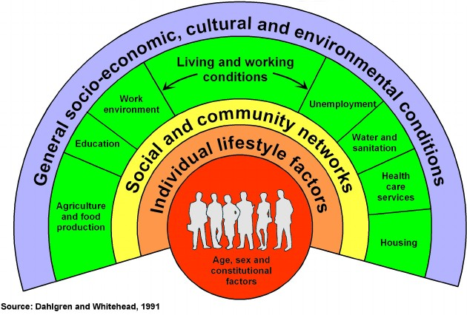
Determinants of Health
Applied Sciences for Physiotherapy Practice (PT7001)

Slide 22
How does this fit into the module aim?
Develop & apply knowledge & understanding of sciences which affect health and wellbeing:
  Biology – Anatomy, Physiology, Pathology, Pharmacology
  Social Aspects
  Psychology

Slide 23


Applied Sciences for Physiotherapy Practice (PT7001)
Part A – Introduction to Module
Psychological
Biological
Social

Slide 24
Health Psychology
Core Psychological Theories
  Human Functioning
    Lifespan
Applied Sciences for Physiotherapy Practice (PT7001)
Part A – Introduction to Module
Psychological
Biological
Social

Slide 25
Health Psychology
Core Psychological Theories
  Human Functioning
    Lifespan
Applied Sciences for Physiotherapy Practice (PT7001)
Part A – Introduction to Module
Psychological
Biological
Social
Sociology
Understanding of health
and illness
  individuals
populations

Slide 26
Health Psychology
Core Psychological Theories
  Human Functioning
    Lifespan
Applied Sciences for Physiotherapy Practice (PT7001)
Part A – Introduction to Module
Biological
Anatomy (structural, functional)
Physiology (muscle, respiratory, digestive, skeletal,
cardiovascular, nervous systems)
  Pathology (and healing)
Psychological
Biological
Social
Sociology
Understanding of health
and illness
  individuals
populations

Slide 27
Health Psychology
Core Psychological Theories
  Human Functioning
    Lifespan
Applied Sciences for Physiotherapy Practice (PT7001)
Part A – Introduction to Module
Biological
Anatomy (structural, functional)
Physiology (muscle, respiratory, digestive, skeletal,
cardiovascular, nervous systems)
  Pathology (and healing)
Psychological
Biological
Social
Sociology
Understanding of health
and illness
  individuals
populations
HEALTH & WELLBEING

Slide 28
How does this fit into the module aim?
Discuss the components of human anatomy, physiology and behavioural science including the dynamic relationships of human structure and function as related to the neuromuscular, musculoskeletal, cardiovascular, and respiratory systems.
Apply a biopsychosocial model to identify possible dimensions of human functioning that may be implicated in individuals with dysfunction related to the neuromuscular, musculoskeletal, cardiovascular, and respiratory systems, including the social and cultural influences on health of individuals and populations.
Discuss the effect of pathological processes underlying common clinical conditions seen in contemporary practice
Justify the rationale for interventions using a biopsychosocial model to optimise health and functioning in individuals and populations.

Slide 29
A Case of 2 Rotator Cuffs
Case 1 | Case 2
36-year-old male, right rotator cuff tear | 36-year-old male, right rotator cuff tear
Difficulty elevating arm beyond 90 degrees | Difficulty elevating arm beyond 90 degrees
Manager within local council’s housing department – still in work | Self-employed fisherman
Married with a young family | Single, lives with parents, but on waiting list for council house
Runs local children’s football club and has a strong social network with other parents | No specific social network, longstanding history of depression

Slide 30
Short Case Study (anonymised):
Mr French - 60 years old, 5’10 (178cm), 95kg (15 stones).
Presenting condition: Neck & upper back pain, pain between shoulder blades & some shoulder pain.
History of presenting condition: Has had these pains for over 10 years, has had three steroid injections in his upper back (between the shoulder blades). This is affecting his gym training.
Mechanism of Injury: Client not sure
Diagnostic imaging: He has wear and tear in the lower neck, but didn’t have his scans
available.
How severe is the pain: 7/10 at worst, 2/10 at best
Nature of pain: Dull ache, sometimes gets headaches with dull ache.
Irritability: Comes on after a few hours of sitting at a desk, then doesn’t go away
Functional Scale (patient specific):
client scores being able to do desk work at 4/10, and gym train 5/10

Slide 31
Short Case Study (anonymised):
Mr French - 60 years old, 5’10 (178cm), 95kg (15 stones).
Past Medical History: Nothing significant to this case.
History of presenting condition: Has had these pains for over 10 years, has had three steroid injections in his upper back (between the shoulder blades). This is affecting his gym training.
Medication: Nil

Slide 32
Short Case Study (anonymised):
More information:
Consultant said surgery might help with his symptoms, but the risks of damage is high, so he
doesn’t recommend surgery.
Has been gym training for 30 years of his life (several times a week, strength training). Can bench press 120kg. Does total body workouts, sometimes struggles with lat pull-downs (as he gets shoulder pain). Has always been heavy and strong.
Gym training is really important to Mr French. He has a gym at his house, but he has also been training in the same gym for 15 years+, and he has made a lot of friends there.
GP told him to stop training.
He is a website designer and graphic designer, his work is affected.
Sometimes drinks wine when the pain is bad.

Slide 33
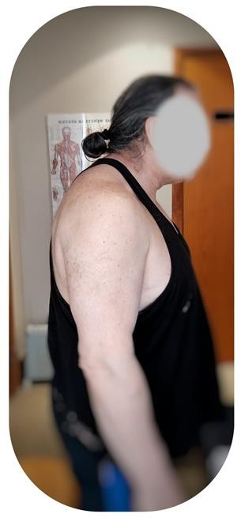
Short Case Study (anonymised): Mr French

Slide 34
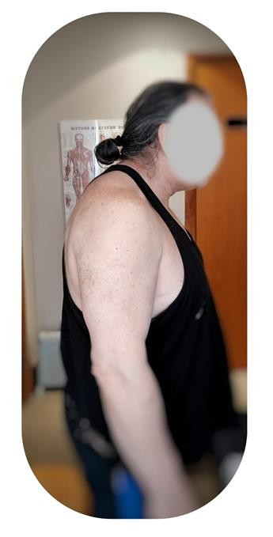
Short Case Study (anonymised): Mr French
Factors | Bio | Psych | Social
Pain
Work (affected)
Gym
Friends
Alcohol
Sleep
Friends

Slide 35
Approach:
12 sessions over 18 weeks
6 in 4 weeks (once+ a week)
4 in 8 weeks (once every other week)
2 in 6 weeks (once every third week)
Expectations: It may not be possible to eliminate pain, but we can improve
function.
Manual Therapy (lots of it) - regain strength through range.
Supervised gym session.
Home visit – ergonomic assessment.
Movement analysis – focus on strength through full range of movement. Activity Modification - Reducing number of strength training sessions, but encourage attendance to the gym by alternating with swimming sessions. Sleep posture.
Discussion about alcohol and quality of sleep. Use of home gym.
2 6 / 0 9 / 2 0 2 2
I R V I N D S I H O T A
2 9

Slide 36
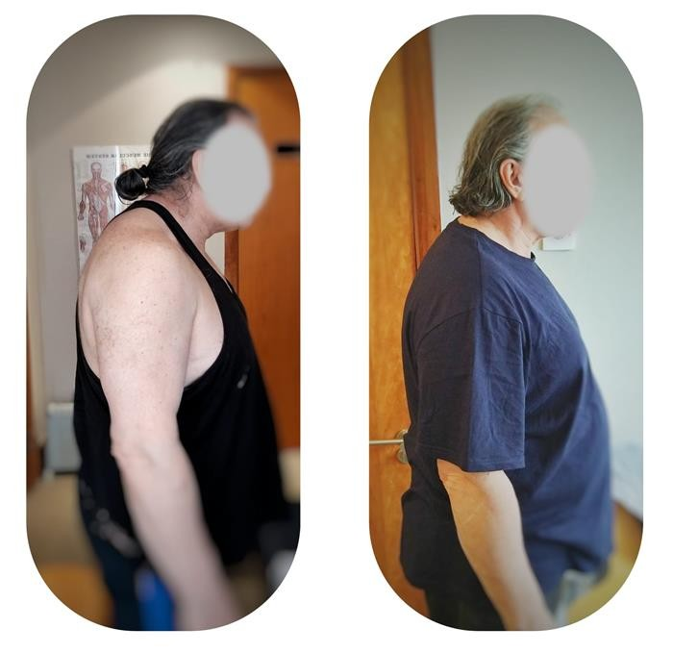
Short Case Study (anonymised): Mr French
How severe is the pain: 4/10 at worst, 0/10 at best
Irritability: No change – but he doesn’t wait for the pain to develop.
Functional Scale (patient specific):
Desk work at 9/10, and gym train 9/10

Slide 37
Contact:
Module Lead: Ngozi Onuegbu PhD
Email: n.onuegbu@londonmet.ac.uk

Slide 38
References
Borrell-Carrió, F., Suchman, A. L., & Epstein, R. M. (2004). The biopsychosocial model 25 years later: principles, practice, and scientific inquiry. The Annals of Family Medicine, 2(6), 576-582.
https://www.annfammed.org/content/annalsfm/2/6/576.full.pdf
Porter S. (2017). Psychologically Informed Physiotherapy: Embedding Psychological Perspectives within clinical management. Elsevier. London
Engel, G. L. (1977). The need for a new medical model: a challenge for biomedicine. Science, 196(4286), 129-136.
Minuchin, S., Rosman, B.L. & Baker, L., 1978. Psychosomatic Families: Anorexia Nervosa in Context. Cambridge, MA: Harvard University Press.
Kiel, L.D. & Elliott, E., eds., 1996. Chaos Theory in the Social Sciences: Foundations and Applications. Ann Arbor, MI: University of Michigan Press.
von Bertalanffy, L., 1975. Perspectives on General System Theory: Scientific-Philosophical Studies. New York, NY: George Braziller, Inc.

